Slide 1


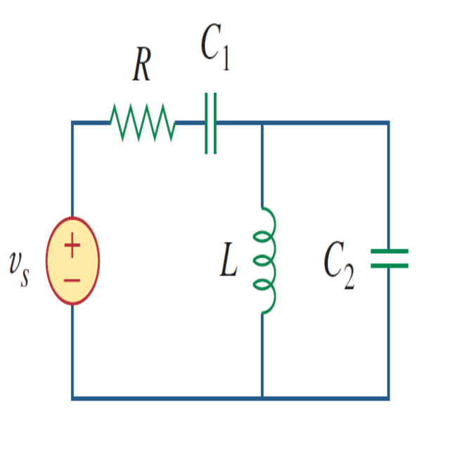
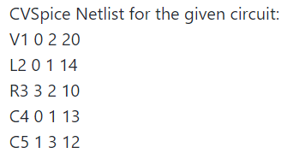
CV Spice
Given an electric circuit image, outputs netlist describing components and their corresponding connectivity

Slide 2
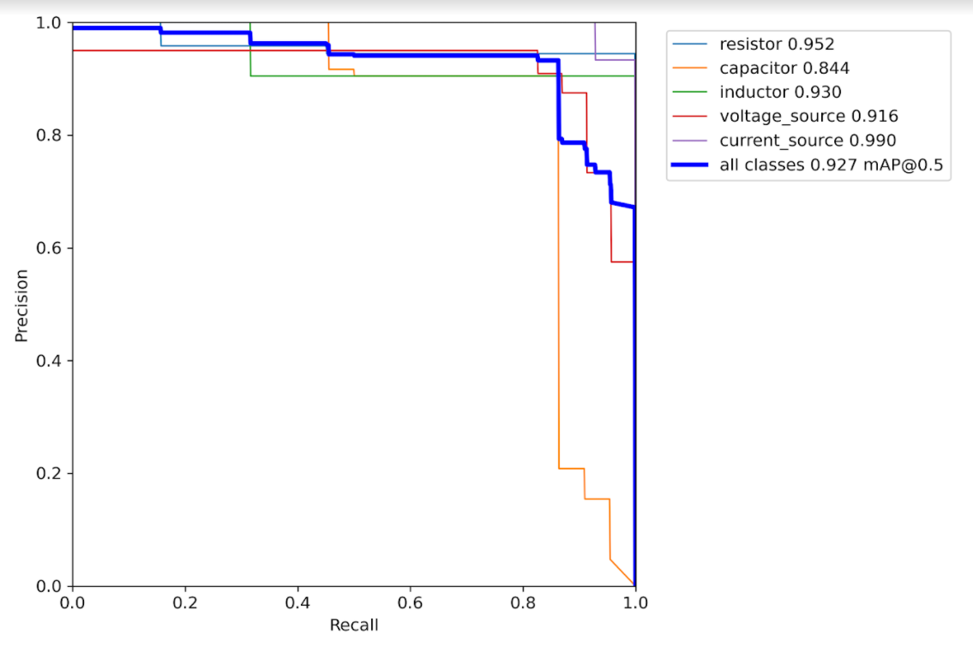
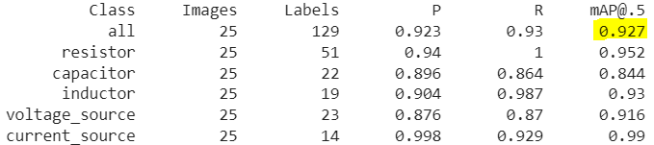
Identification of Circuit Components
We have used YOLO v5 for detecting circuit components
We collected custom dataset containing around 350 circuit images.
Annotated these images and trained it using YOLO v5 object detection model.
The mAP (mean Average Precision) score of the model evaluated with 25 images is 92.7%.

Slide 3
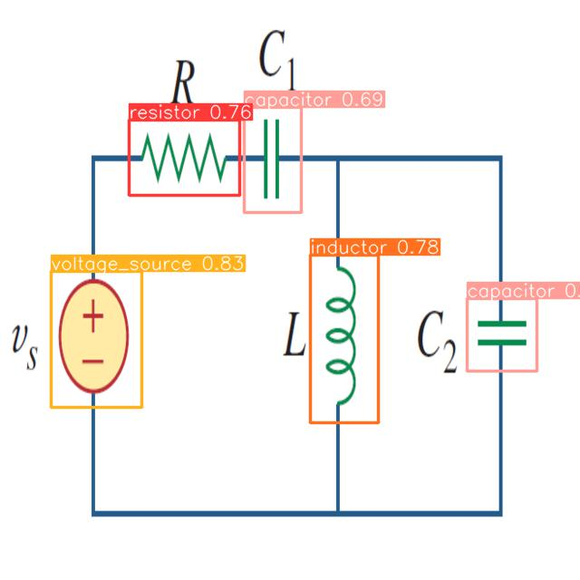
Component classification using YOLO v5
Given a circuit image the trained YOLO v5 model outputs the image with bounding boxes and the corresponding class of the component.

Slide 4
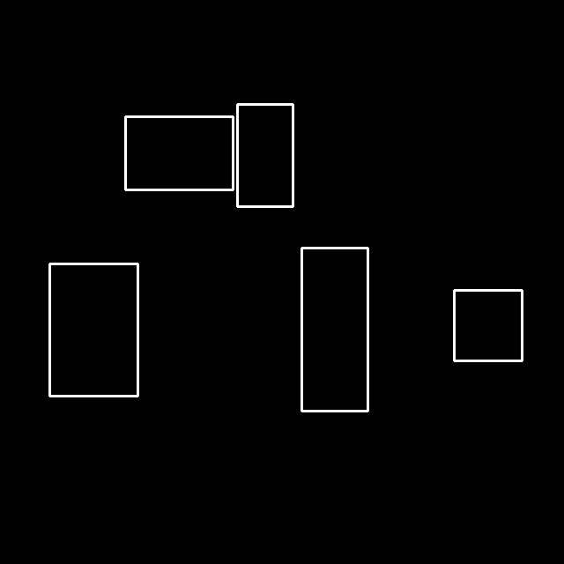
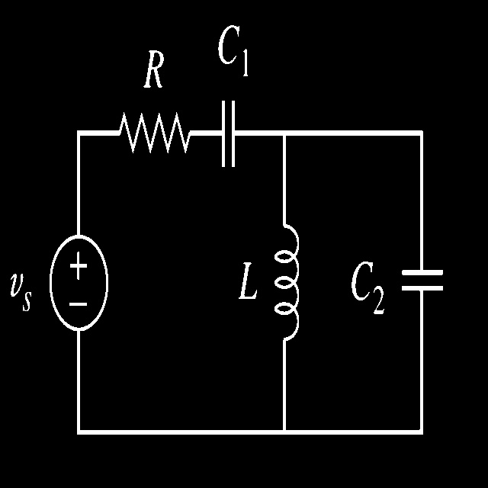
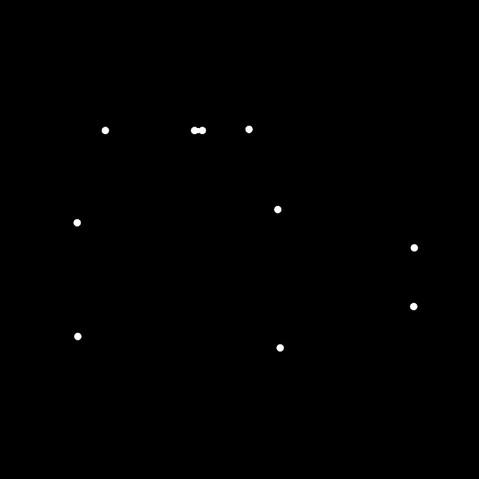
Identification of Component’s terminal points
Terminal points of the circuit components are found by intersection of binary image of A-bounding boxes and B-adaptive thresholding of the original image.
(A and B) = terminal points
and =

Slide 5
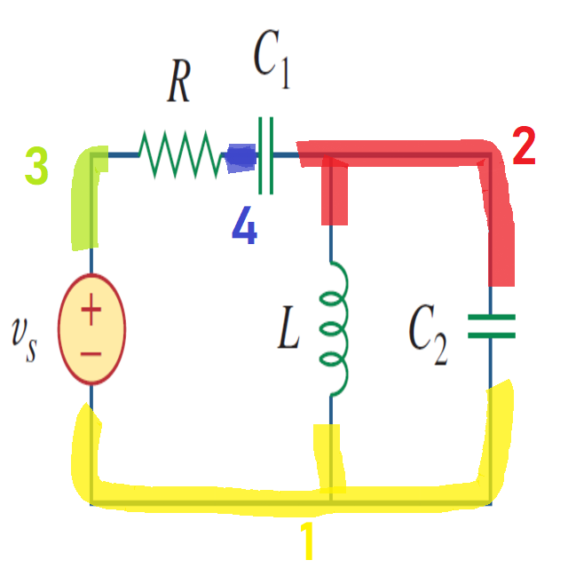
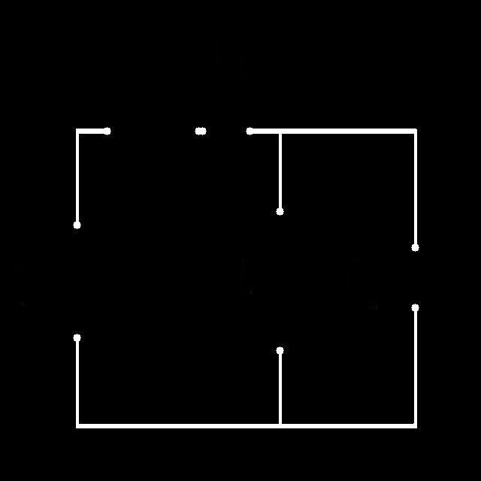
Identification of Nodes
The nodes of the circuit are found using Breadth First Search(BFS) algorithm.
The circuit image with components removed is given as input to the BFS.

Slide 6
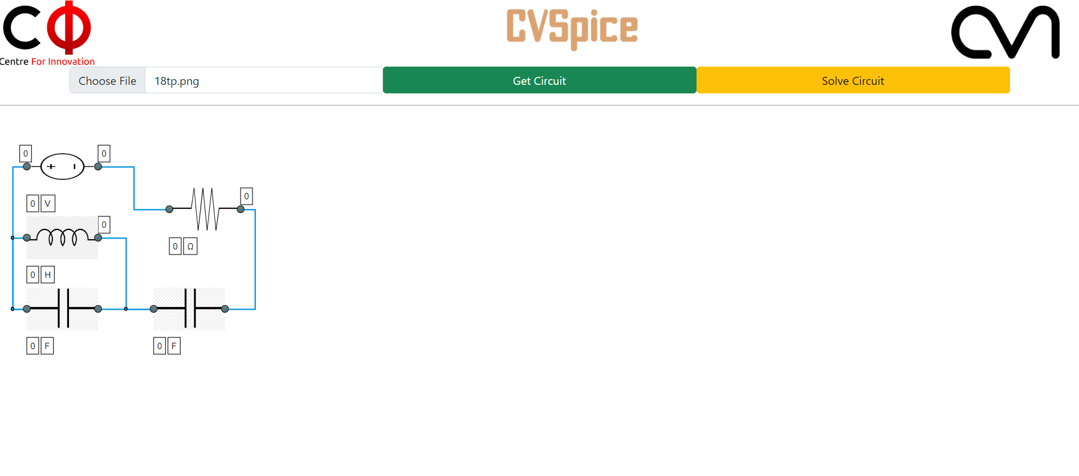
GUI
A Graphical User Interface has been developed for the project, for ease of operation by end users using HTML, CSS, JavaScript and Flask.
Original Circuit

Slide 7
Breadth First Search(BFS)
Breadth First Search is performed on the binarized version of the image.
The algorithm starts executing Breadth First Search from the terminal points of the components detected in the image.
Starting from one terminal point, the algorithm discovers other terminal points connected to it using a wire.
All terminals which are connected to each other form a node.
The algorithm works by maintaining a queue data structure. The queue contains pixel coordinates which are white in color (indicating wire).
For every pixel coordinate the neighbours which are white in color and have not been visited are added to the queue, and the algorithm keeps running till the queue is empty.
We continue the Breadth First Search procedure from each terminal pixel which has not been visited yet.

Slide 8
Why Use BFS?
Using the breadth first search approach allows determining connections between various terminals even if the wires are not straight lines (could be circular or any other shape).
It can be easily extended to work well with hand drawn circuits which may not have a regular shape or can be distorted provided the image has been binarised appropriately.
The netlist of the circuit should be invariant of the way the circuit is drawn on paper. Using BFS, allows mapping different circuit diagrams representing the same circuit to the same netlist, irrespective of the way the diagram is drawn.

Slide 9
What is the output netlist?
A netlist contains information about the connectivity of the circuit components with others.
Components (R,L,C,Voltage source,Current source).
Nodes - the terminal points between which the components are connected.
Value of each component - given by user.
Values given by the user
Component
`
Nodes between which the component is connected
``

Slide 10
Thank You

